Slide 1
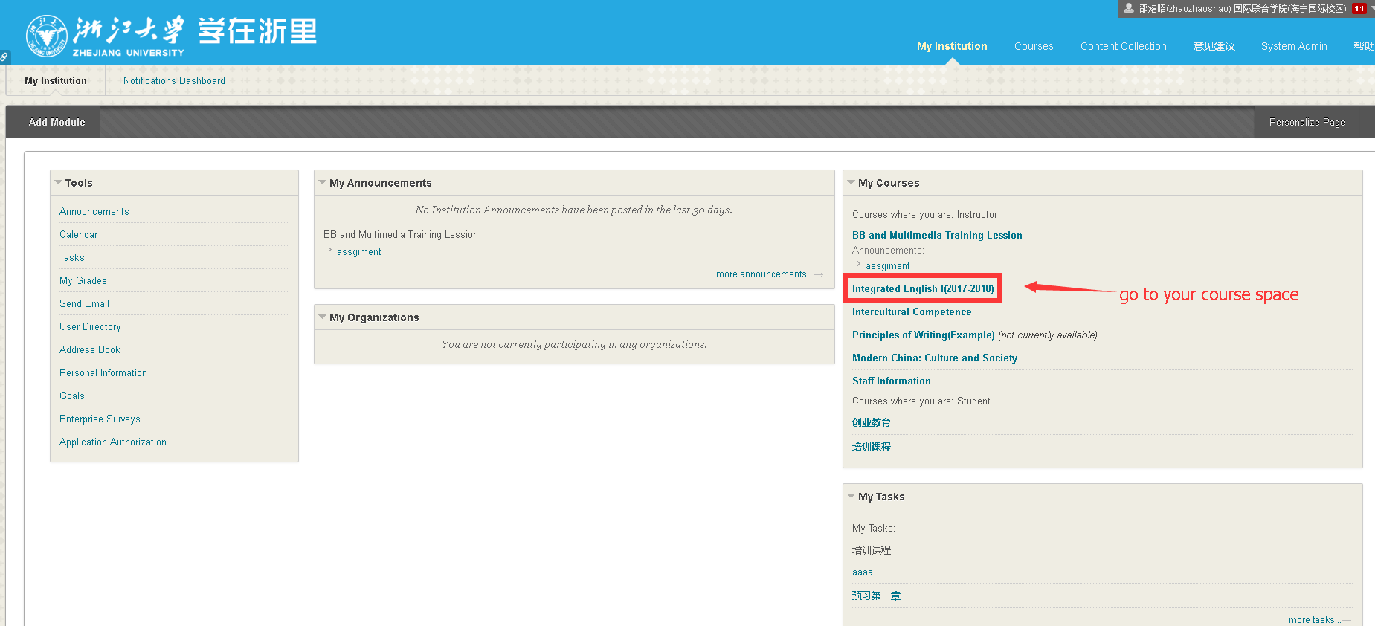
Create a Turnitin Assignment in Blackboard
Go to your course space

Slide 2
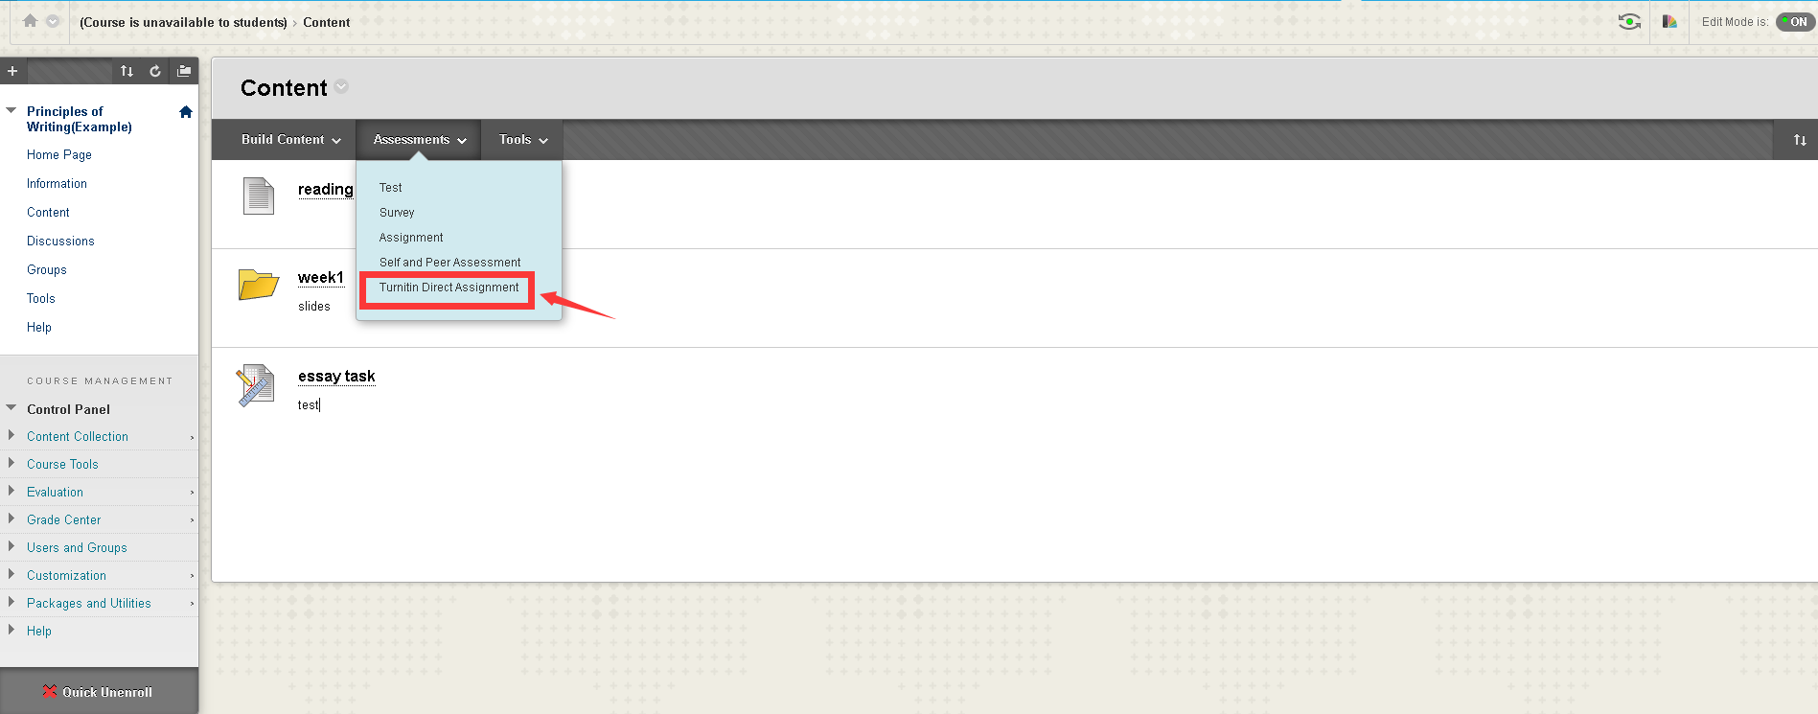
Create a Turnitin Assignment in Blackboard
2. Create a Turnitin Assignment

Slide 3
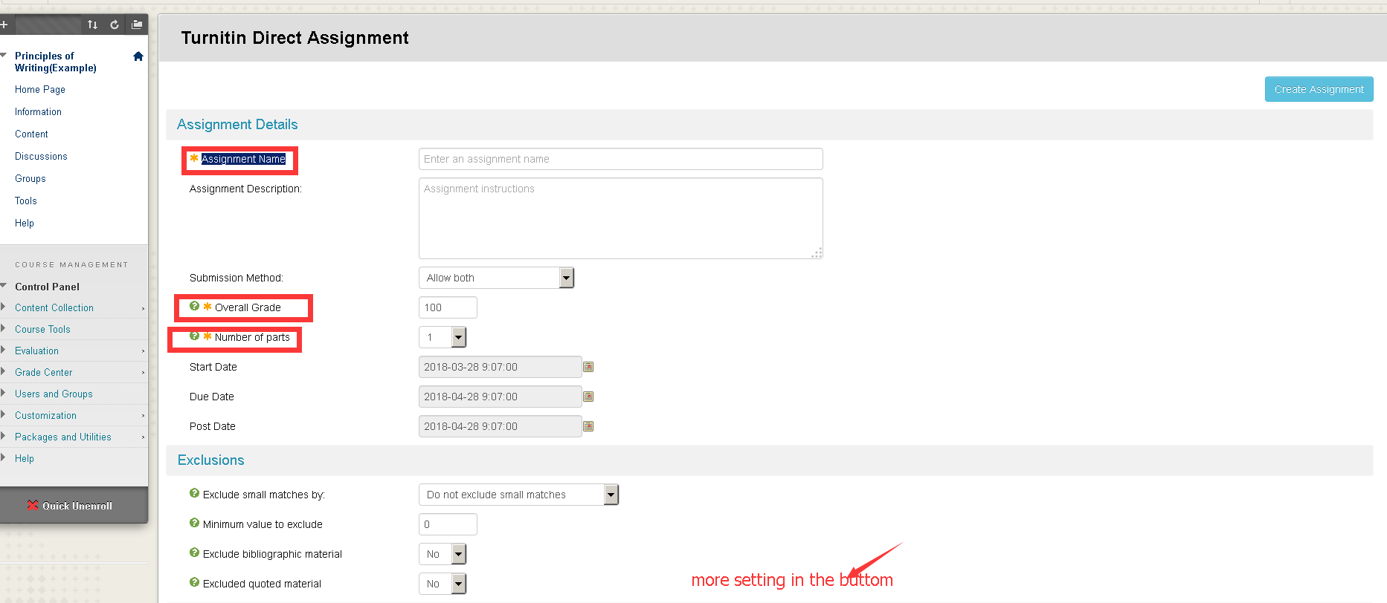
Create a Turnitin Assignment in Blackboard
3. Create assignment details such as assignment name, the total scores, and the parts of assignment(in case assignment requires several components)

Slide 4
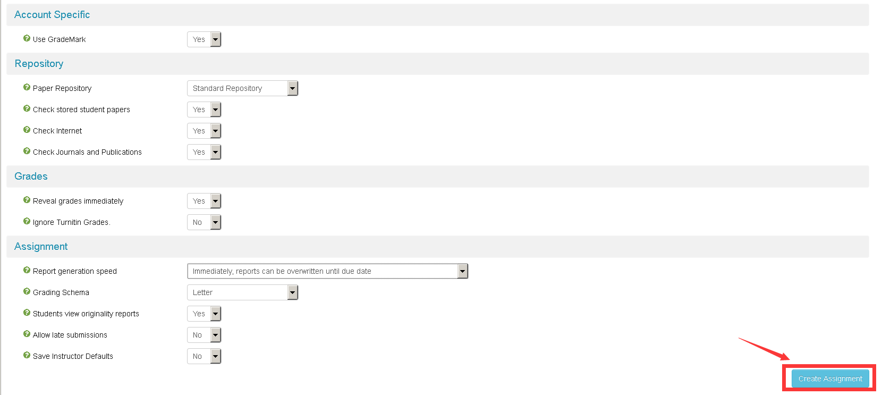
Create a Turnitin Assignment in Blackboard
Following previous slide, you can make specific setting in the buttom of the page

Slide 5
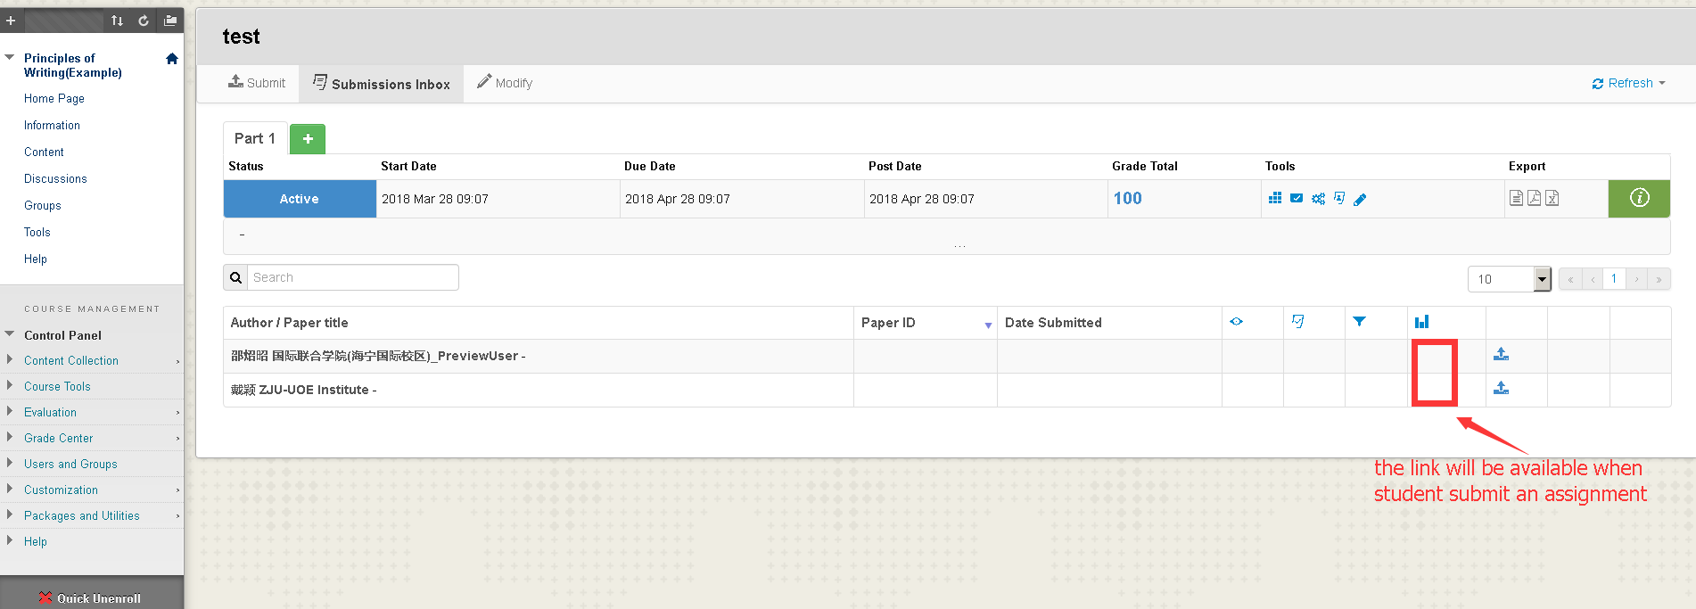
Create a Turnitin Assignment in Blackboard
4 Wait for student submit assignment

Slide 6
Create a Turnitin Assignment in Blackboard
The plagiarism will take hours as it scan the global database

Slide 7
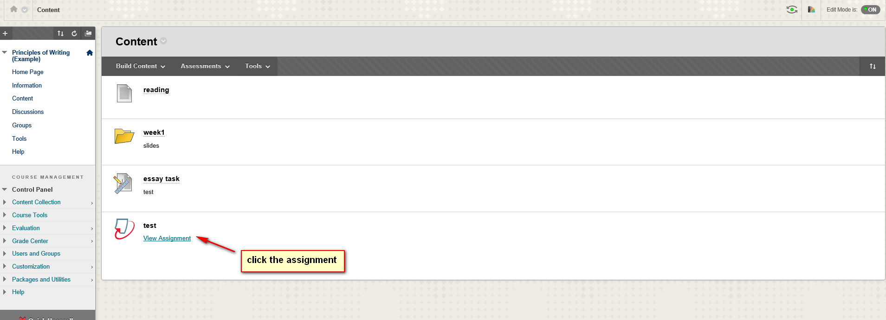
Submit your assignment in blackboard
Find your assignment

Slide 8
Submit your assignment in blackboard
Click the submit button

Slide 9
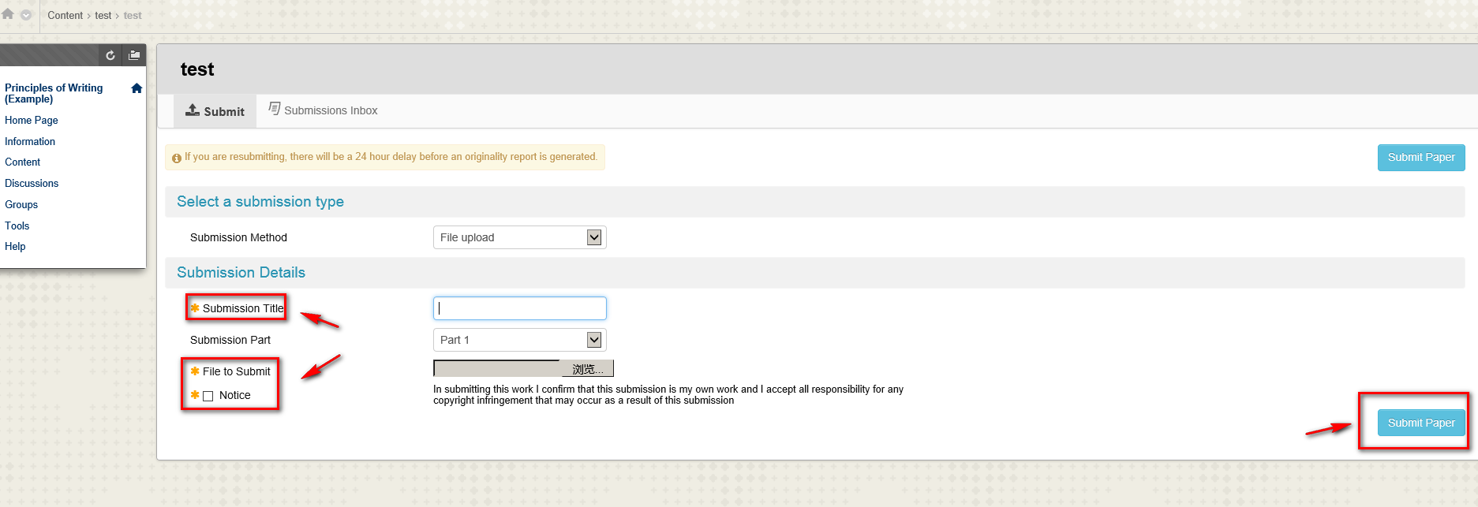
Submit your assignment in blackboard
Please to fullfil all information, “submission Part” will be Part 1 nomally

Slide 10
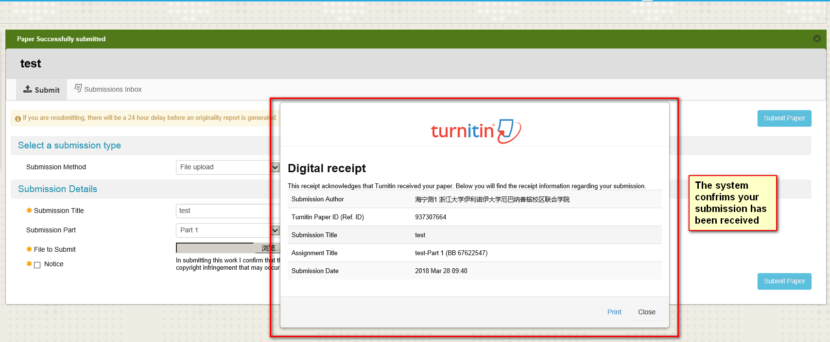
Submit your assignment in blackboard
The system confirms that your submission has been received

